Slide 1
Bases

Slide 2

By the end of this lesson you should be able to:
Define a base.
Explain how bases dissolve.

Slide 3
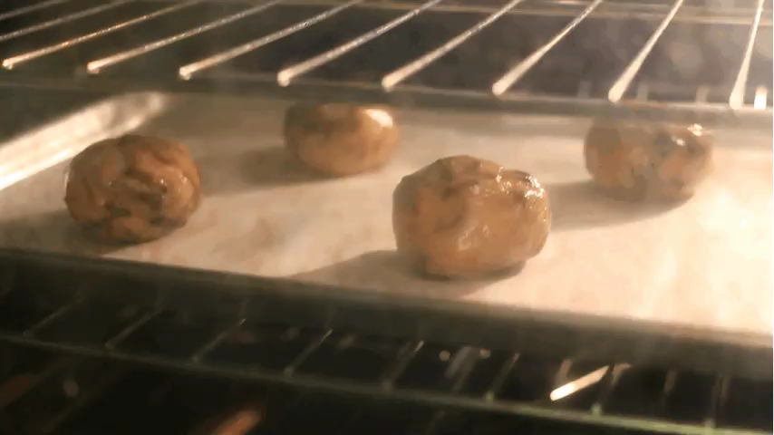
Much like acids, bases are mainly used to react.
Bases are also called alkalis, and a base can be described as basic or alkaline. They can be found as solid crystals or solutions.
Basic substances include things like baking soda, bleach, and caustic soda.

Slide 4

Baking soda is the most important ingredient for creating baked goods.
Also known as sodium bicarbonate, this basic substance reacts with acids in, for example, bread dough to create gas. The gas makes bubbles in the mixture and these bubbles make the bread rise.
The formula of sodium bicarbonate is NaHCO₃​.

Slide 5
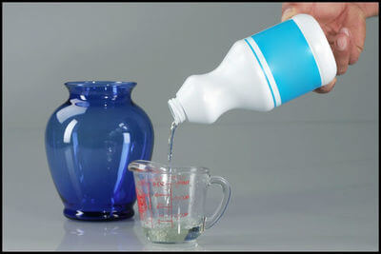
Bleach is one of the most common household cleaners.
Liquid bleach is usually a mixture of water and sodium hypochlorite. It is frequently used as a disinfectant due to its ability to kill harmful microbes. It is also very caustic and will cause burns on too much contact.
The formula of sodium hypochlorite is NaOCl.

Slide 6
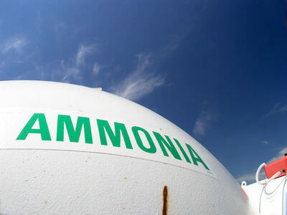
A different alkaline cleaning product is ammonia.
Ammonia can be used as a cleaner, but has a very strong reaction with bleach that can create toxic gas, so these substances should be handled carefully if together. It is also a fertilizer that provides nitrogen to plants, and it can even be used as a fuel.
The formula of ammonia is NH₃​.

Slide 7

All bases have similar chemical properties.
Most commonly, bases react with acids.
Bases are usually also caustic (when very concentrated), taste bitter and conduct electricity. A lot of basic cleaners in particular will also feel slippery (for example, soap).

Slide 8
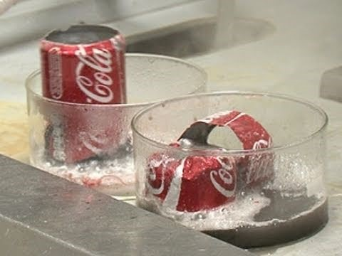

Slide 9
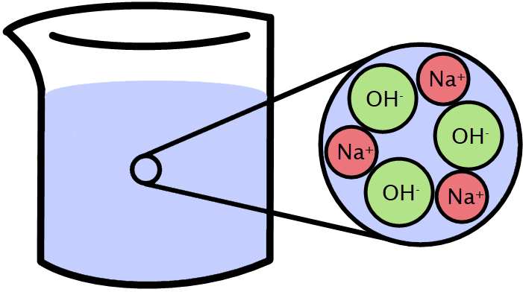
Much like acids, bases are usually crystals in solid forms, and will dissolve in water to make an alkaline solution.
Dissolving a base separates it into the ions that make it up.
A strong base, like sodium hydroxide (NaOH), dissolves into the reactive ions Na⁺ and OH⁻.

Slide 10
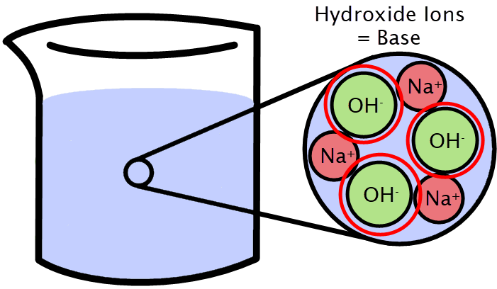
Bases are defined as chemicals that release hydroxide ions when dissolved into a solution.
The hydroxide ion (OH−) is negatively charged, and is a molecule made up of one hydrogen atom and one oxygen atom.

Slide 11

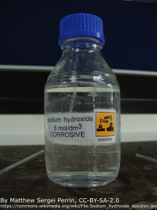
Equations for the dissolution of a base can be written as:
Base → Negative Hydroxide Ion + Positive Ion
For example, sodium hydroxide (with the formula NaOH) dissolves in water by the below equation:

